Slide 1



Starting A New Christian School
A Process for Building a Strong Foundation

Slide 2
About Christian Schools International (CSI)
As a leader in Christian education services, our mission is to support schools in their task of teaching students to know God and his world, and to glorify him through service to others.
Founded in 1920, Christian Schools International was the first national organization to exclusively serve Christian schools.
We believe faith and learning are inseparably linked, with God’s Word as the foundation for truth found in every academic subject.
Whether through accreditation, curriculum, or leadership development, we’re dedicated to increasing the effectiveness of Christian schools as they seek to transform the world for Christ.
https://csionline.org/about

Slide 3

About the Iowa Association of Christian Schools (IACS)
Founded in 1976, the mission of IACS is “Strengthening, Growing, and Advocating for Christian Schools in Iowa.”
Currently representing 120 Iowa schools, IACS is the only organization created specifically to serve Iowa Protestant Christian schools.
We represent Christian schools in public policy both by tracking legislation/public policy to provide information to member schools, as well as advocating on behalf of our member schools in the Iowa Legislature. IACS also educates Iowans on the benefits of school choice programs and Christ-centered education, helping build a culture of educational excellence and school choice in Iowa.
IACS is equipped with the unique ability to assist new and established schools in the areas of school improvement, consulting, professional learning, policy, advocacy, and accreditation preparation – all from an Iowa-specific perspective.
https://www.iowachristianschools.org/

Slide 4


The Process
IACS Assigns a Coach
Introduction of Coach and Modules
Module Checklist
Module Resources
Coaching between Modules
Completion of Modules
After completion of the Modules Process and a referral by your Coach, your school may apply for CSI Membership and Candidacy with Provisional Accreditation Status and become eligible for Iowa’s Education Savings Account (ESA) program

Slide 5


The Modules
Module 1:
A Firm Foundation
planning, purpose, mission, vision, philosophy, educational goals, statement of faith, establishment, governance model, accreditation, insurance, community partnerships
Module 5:
Finishing Touches
Module 2:
Building Up
furnishings, supplies, employee trainings, orientations, registration, student supervision, safety drills, conferences, traditions, continuous improvement
facilities, fundraising, parent/student handbook, employee handbook, board policy manual, budget, tuition modeling, tuition support, organizational chart, personnel, hiring process
Module 4:
Adding Details
Module 3:
The Core
marketing, admissions, lunch, playground, schedule, calendar, co-curricular activities, transportation, security, communication, volunteers, records
curriculum, instructional materials, graduation requirements, technology, assessments, behavior plan, special services, worship opportunities, service opportunities

Slide 6

Independent Accreditation in Iowa
Independent accreditation is important to Iowa’s Christian schools.
Independent accreditation allows Christian schools to choose an accrediting body that understands and respects its role and mission as a faith-based school.
Independent accrediting agencies are not simply compliance-based accreditation models but are founded on increasing accountability while simultaneously increasing flexibility and keeping Christian schools accountable to their stated mission, purpose, and goals as an education institution.
Without exception, Christian schools accredited by CSI find the process to be extremely meaningful, impactful, and more rigorous than other options.

Slide 7
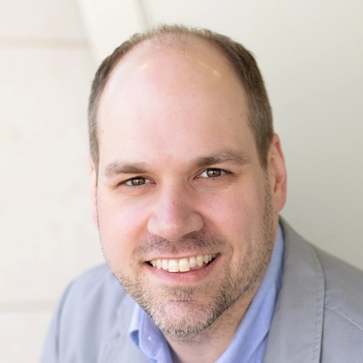
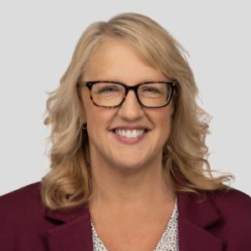
We look forward to the opportunity to work with you and your school!
Please contact Josh Bowar, IACS Outreach Director, at
josh@iowachristianschools.org Cell 320.979.9598
or
Sheryl Jo, CSI Director of Accreditation, at
sjo@csionlione.org Cell 616.617.4361

