Slide 1

Enlightium Academy
Empowering Christian schools through cutting-edge technology, academic excellence, and operational optimization for more than 20 years.

Slide 2
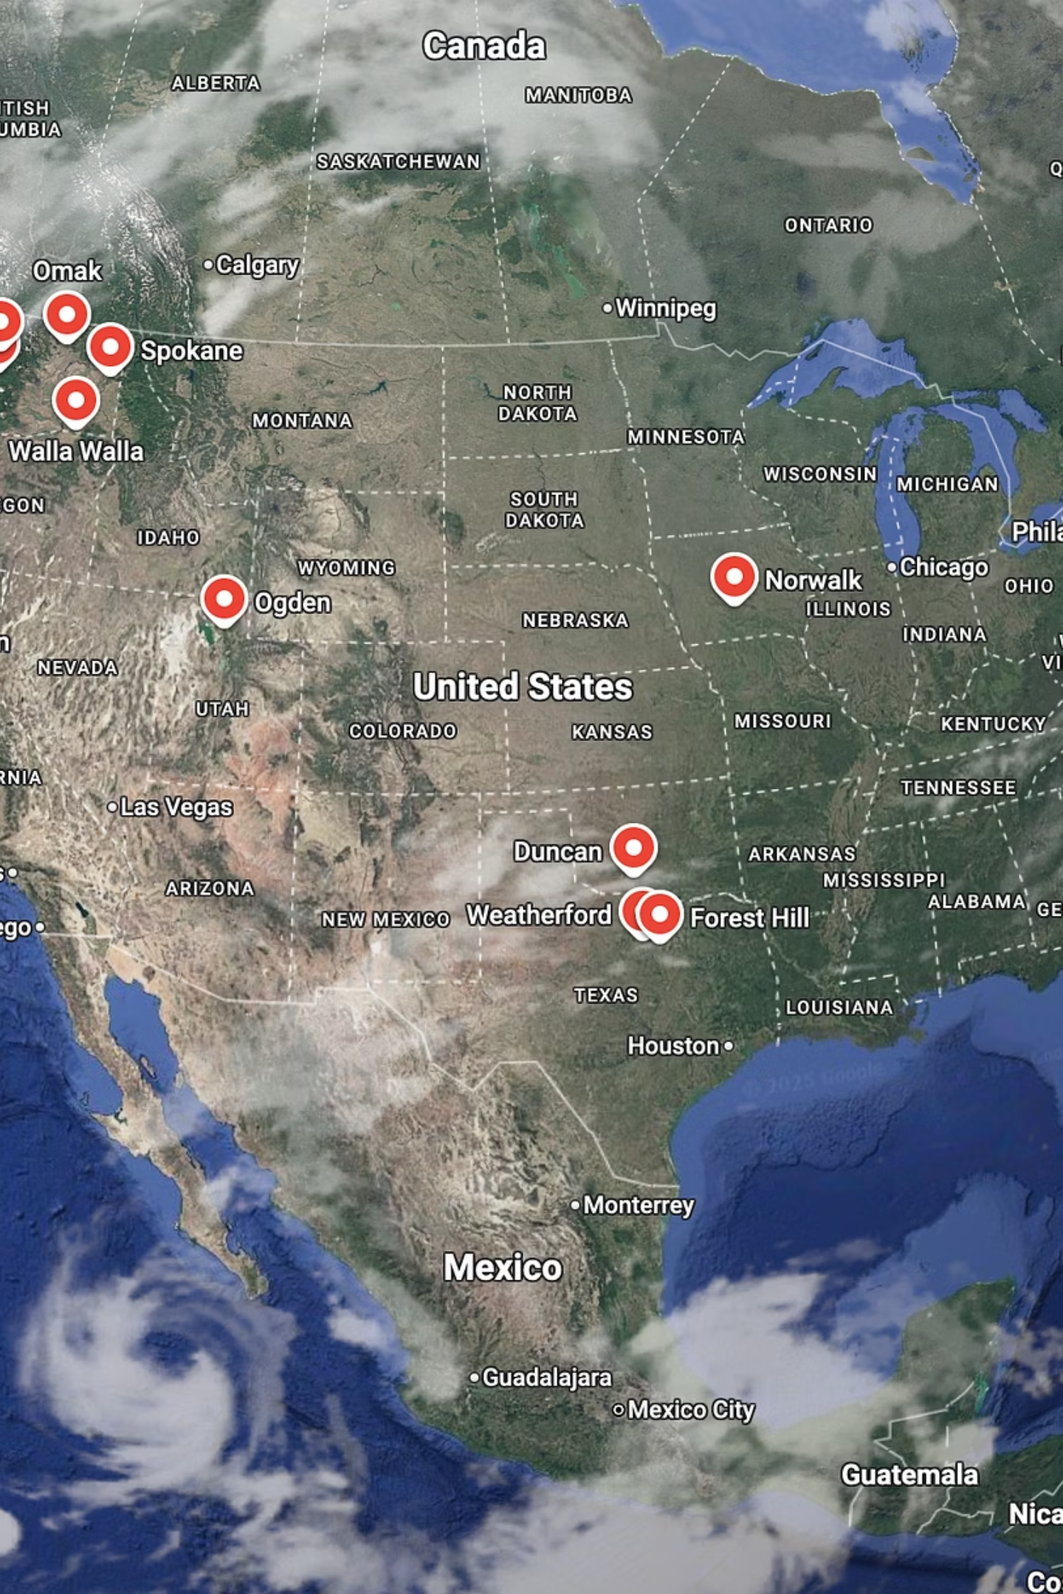
About Enlightium Academy
Global Reach & Impact
Distinctly Christian Identity
Serving thousands of students and dozens of Christian schools across the globe with tailored educational solutions.
Our unwavering commitment is to a Christ-centered education, integrating faith and learning in every aspect.
Academic & Operational Excellence
We empower schools with cutting-edge technology and proven strategies for both academic rigor and efficient operations.

Slide 3



Partner School Services
Curriculum Guidance
We provide a selection of biblically aligned curriculum options, inluding both print and digital, customized to meet your specific needs.
Teacher Services
Access qualified faculty that share your Christian values to support your students in their course work. Teachers can be provided to solve staffing issues or as a permanent solution.

Slide 4

Affordable Excellence
Full-time Course Load
Offer a full grade level of courses as needed. For high school students with teacher support: less than $2,500 per student per year.
Part-time Option
Offer students specialized elective courses, upper level math, or world language for as low as $333 per course per student.
We believe that quality Christian education should be accessible to all. Our competitive pricing models ensure that families can provide their children with an excellent, faith-based learning experience without compromising on affordability. We are committed to making a high-standard education attainable for every student.
Curriculum and instructional services can be paid with Iowa's ESA!

Slide 5
Contact Us To Learn More
Phone Number
Email Address
509-319-2288 x 2407
desiree@enlightium.ai
Website
www.enlightium.ai
We encourage all schools interested in providing affordable, high-quality Christian education to their students to reach out. Our team is ready to assist you in exploring how our programs can benefit your community.

